Slide 1

Technical Case
May-2022
Candidate
Name: Leonardo Brozinga Viglino
Email: leovibroz@hotmail.com
Cellphone: +55 (11) 952276757
Linkedin: https://www.linkedin.com/in/leonardo-viglino/

Slide 2
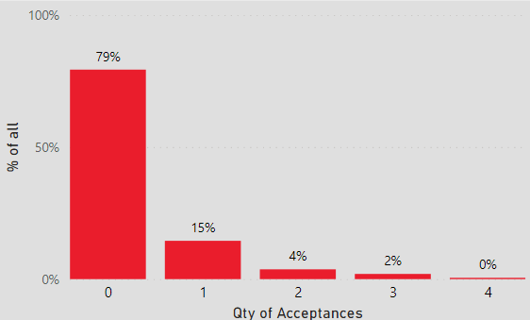
Our Problem
Loss on market campaign based on a new offer
Current Status
5 Campaigns were carried out over 2.240 customers
Gross Income
Total Cost
Profit / Loss
+ 3.674M U
-6.720M U
-3.046M U
667 sales were succesfuly achieved
20% (463 customers) have succesfully bought the product
15% (325) bought only once
Avg Income per sale
5508 U
4% (83) bought twice
2% (44) bought thrice
Cost per contact (2240x5 contacts)
600 U
0.5% (11) bought four times
0 bought the product five times
80% (1.777) never bought the product

Slide 3
Objective
Our Goal
Have a profitable sixth campaign
Current Status
In order to have a profitable campaign we need at least
Quantity of sales per campaign
1
11%
11% of success rate
or 244 sales with 2240 customers
goal
5508 U
600 U
Success Rate
6,4%
7,3%
7,5%
7,3%
In order to achieve this goal our team recommends two improvements:
. Customized Offers
Better designed offers based on customer
historical behavior of purchases
. Public Selection
Based on a predictive algorithm better select customers based on its probability of accepting an offer instead of contacting every customer
1,3%

Slide 4





Objective
Customer Behavior
Our team analyzed each customer’s total spent on each of our 5 categories of products: Wine, Meat, Fruit, Fish and Sweet
On top of that, we managed to detect 4 patterns of behaviors (clusters)
By comparing each cluster to an average customer, it is possible to point out each cluster specific behavior
Current Status
Average Customer
#Enophiles
#Meat&WineCo
#FishLovers
#CandyAnts
they won’t refuse a treat
Wine | 51% | 74% | 41% | 21% | 17%
Meat | 28% | 18% | 40% | 26% | 25%
Fruit | 6% | 2% | 5% | 13% | 23%
Fish | 9% | 3% | 8% | 29% | 10%
Sweet | 6% | 2% | 6% | 11% | 25%
Avg pct of
Total Spent
Share of Total Customers
2240 | 917 | 934 | 259 | 130
100% | 41% | 42% | 12% | 6%
Qty accepted offer
463 | 252 | 183 | 19 | 9
 | 27,5% | 19,6% | 7,3% | 6,9%
% success rate within cluster
It is indeed noticeable higher acceptance rates for customers who drink more Wine

Slide 5
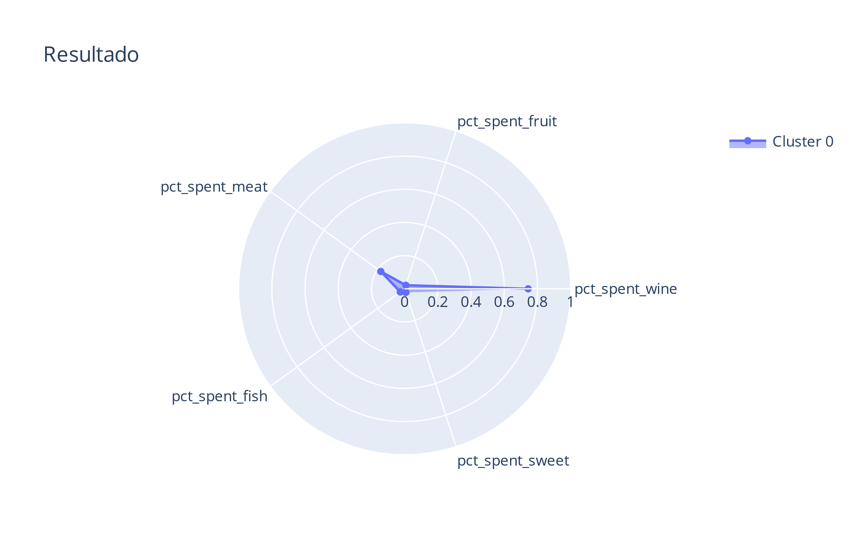
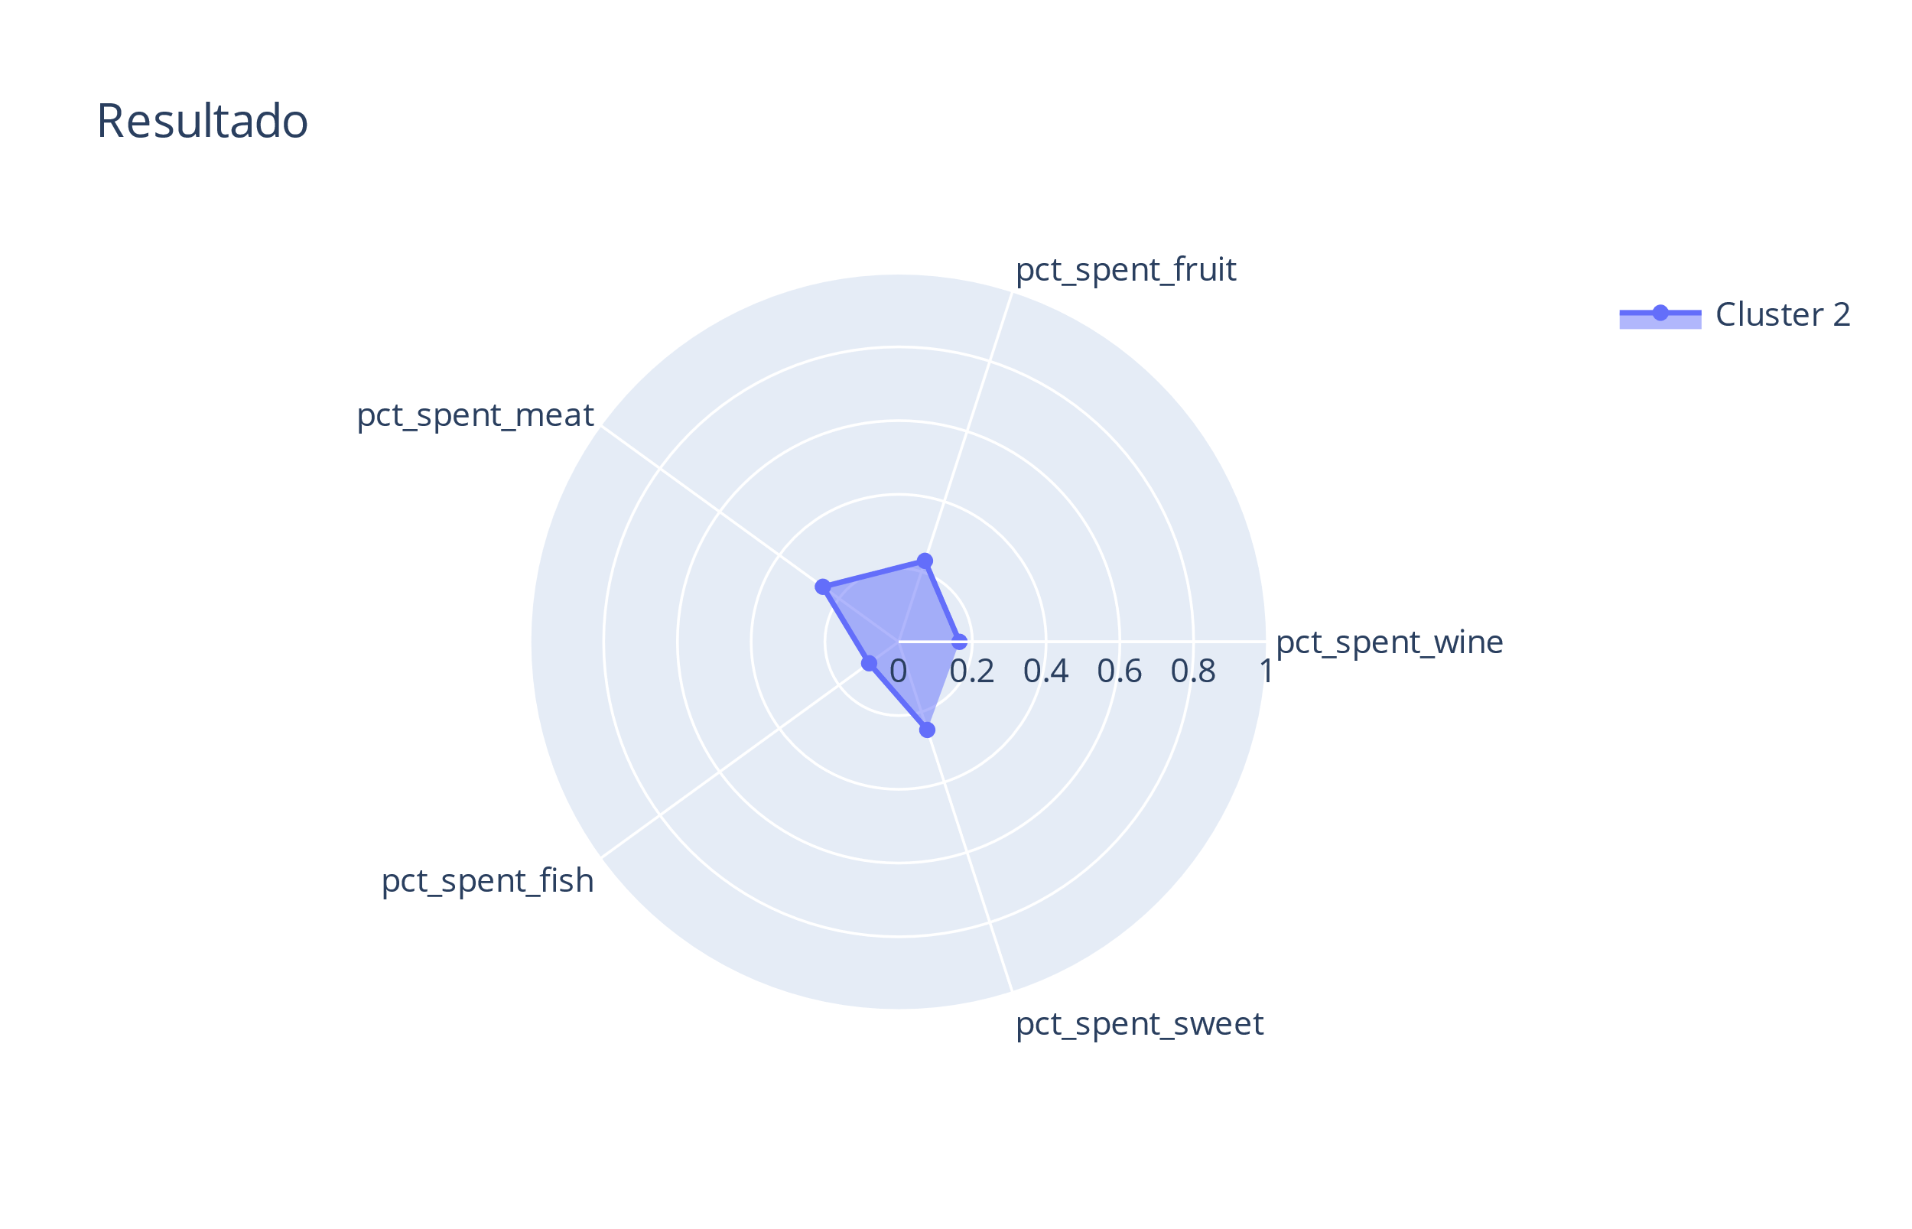
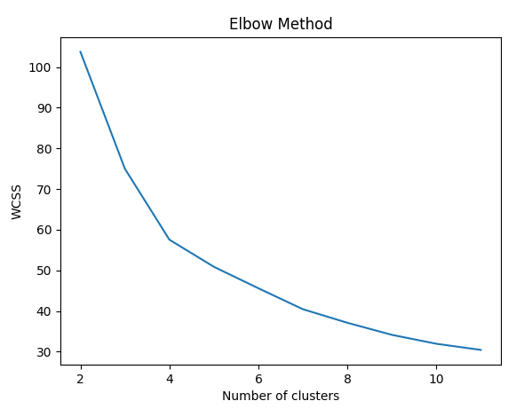
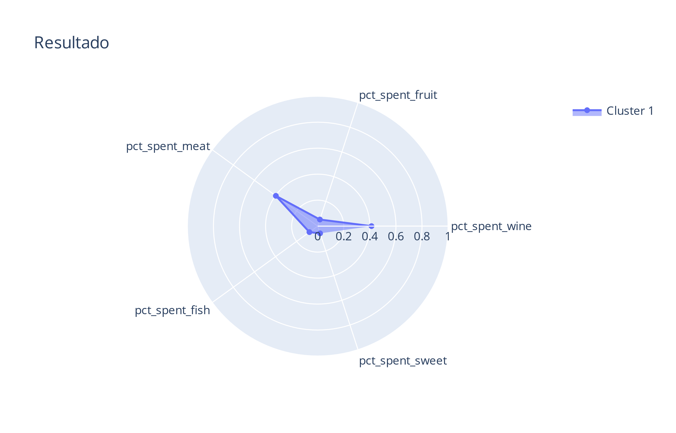
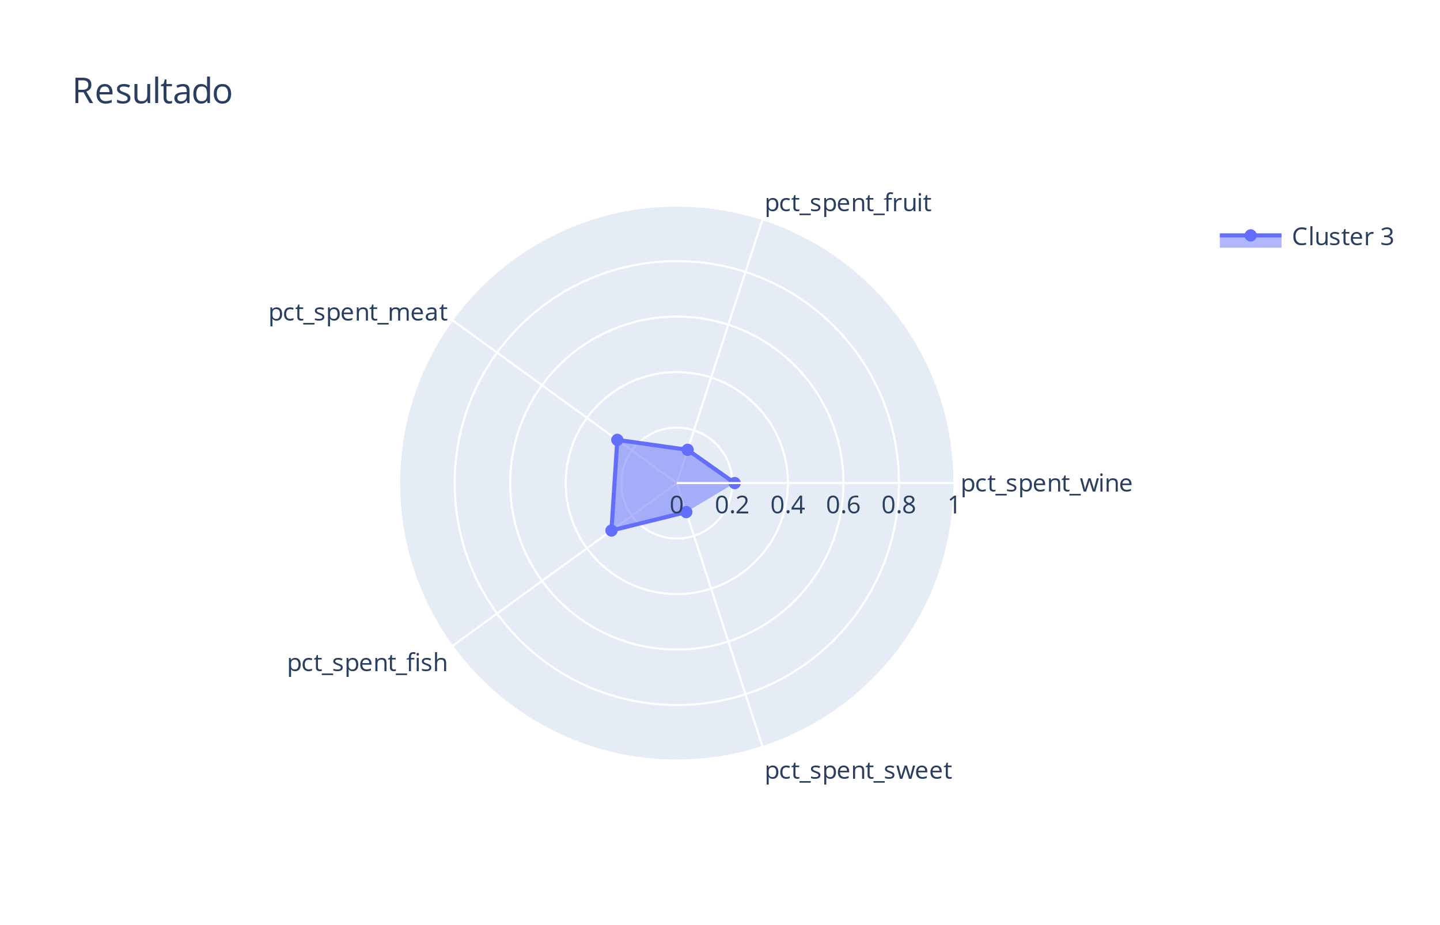
Objective
Clusters
#Enophiles
#CandyAnts
#Meat&WineCo
#FishLover

Slide 6
Objective
Clusters
Avg Spent
 | Avg Customer Behavior | #Enophiles | #Wine&MeatCo | #FishLovers | #CandyAnts
avg pct Spent on Wine | 51,01% | 74% | 41% | 21% | 17%
avg pct Spent on Meat | 28,38% | 18% | 40% | 26% | 25%
avg pct Spent on Fruit | 5,95% | 2% | 5% | 13% | 23%
avg pct Spent on Fish | 8,55% | 3% | 8% | 29% | 10%
avg pct Spent on Sweet | 6,12% | 2% | 6% | 11% | 25%
Delta From Average
 |  | #Enophiles | #Wine&MeatCo | #FishLovers | #CandyAnts
pct Spent on Wine |  | 0,5 | -0,2 | -0,6 | -0,7
pct Spent on Meat |  | -0,4 | 0,4 | -0,1 | -0,1
pct Spent on Fruit |  | -0,6 | -0,1 | 1,1 | 2,9
pct Spent on Fish |  | -0,6 | -0,1 | 2,4 | 0,2
pct Spent on Sweet |  | -0,6 | 0,0 | 0,8 | 3,1

Slide 7
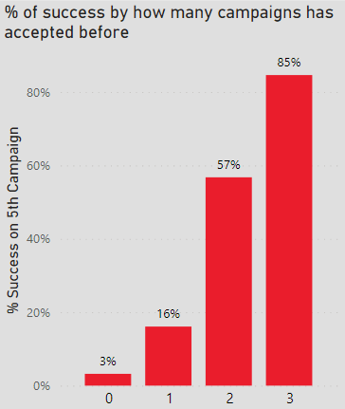
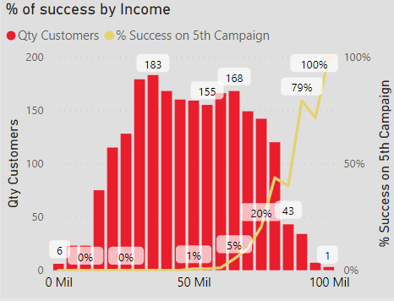
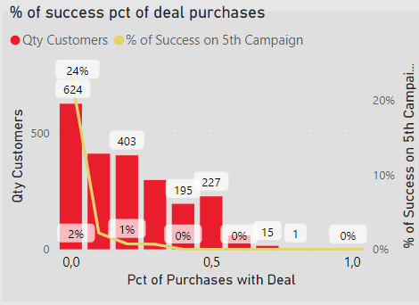
Objective
Public Seletion
Our team analyzed the 5th campaign performance vs. Customer’s characteristics and 1 to 4th campaign responses
It is noticeable that some customers tend to be more receptive to the offer according to its
Income, Qty of offers accepted before (1 to 4th camp) and Pct of Deal Purchases
Current Status
Customers who have already bought the offer before, tend to buy again
Higher the Income, higher the chances of buying the offer
The more Deal Purchases the customer has seeked, less likely it is to buy the offer

Slide 8
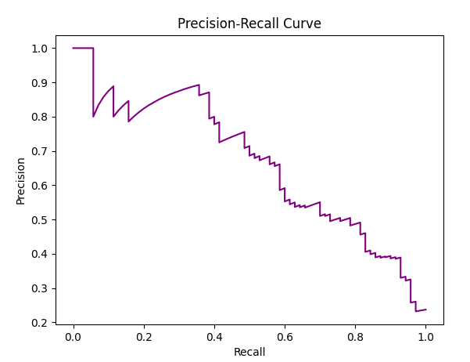
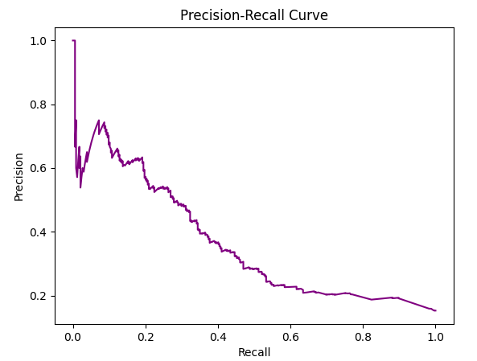
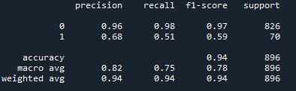
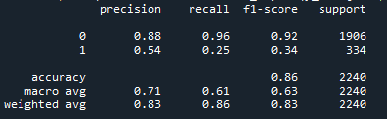
Objective
Public Seletion
Training a XGB Classifier based on 1 to 4th Campaign vs. 5th response as target
(test and train purposes)
Using the trained XGB Classifier to predict the Sixth campaign response and using field ‘Response’ as target
Current Status
Predictions on TEST data
Predictions on VALIDATION data
Overall Accuracy = 0.94
Overall Accuracy = 0.85
The algorithm performs poorly when predicting True Positives
However performs really well when predicting True Negatives
On Validation set, the algorithm has similiar results
Bad performance for predicting who will accept but outstanding performance for who won’t
Overall, the Precision-Recall curve has a bad shape with linear correlation between Precision and Recall
Further analysis will be developed to reach best threshold vs. Profit

Slide 9
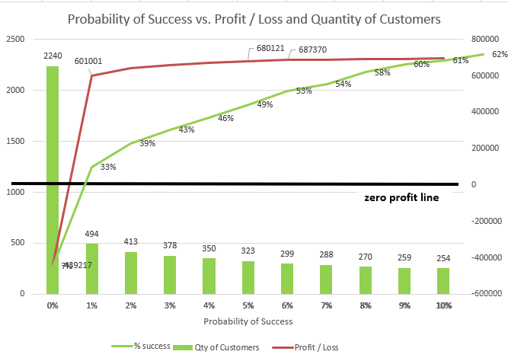
Objective
Public Seletion
Based on these characteristics and a few others, the Analytics Team developed a Classification Algorithm which will give us the probability of each customer to accept the Sixth Campaign. Based on this probability, Avg Cost per contact and Avg Revenue per success the public will be selected
Current Status
As we can see, in order to reach the best result in the sixth campaign we must exclude customers with probability < 6% of success, which make up to 1.941 customers (~86%)
Doing that, we expect a profit of 687370 U on the Sixth Campaign with a success rate of 53%, way above the 11% needed
Although only a few customers remain (299 customers), if the main focus is Profit, this public selection is highly recommended
Further improvements on the offer can be implemented matching contact language and products with our Customer Behavior Segmentation
Previous
Scenario Loss
Best Scenario -> 299 Customers
with probability >= 6%
Profit

Slide 10
Thanks
Created by
Leonardo Brozinga Viglino
May-2022

